Slide 1
Prospero was sent away when Miranda was only 3. They were put on a small boat with holes in and no sails. The boat eventually made its way to an island with no name, where Prospero and Miranda have lived since… The story could have been very different if Prospero knew how to build a ship. Help him to build a ship to rewrite the story so that him and Miranda could return safely to Milan where he could resume his position as Duke…
Lesson 1
slide 1

Slide 2
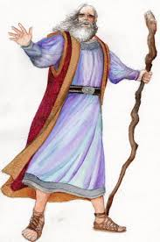
Lesson 1
slide 2
L.O I can create an identification key.
Success Criteria
Float for 3 minutes.
It must be able to hold me (a Lego version of Prospero).
It must move across the water tub when a hair dryer is blown at the sail.
4. The flag design must represent revenge.
Please help me to create a ship and rewrite my fate…

Slide 3
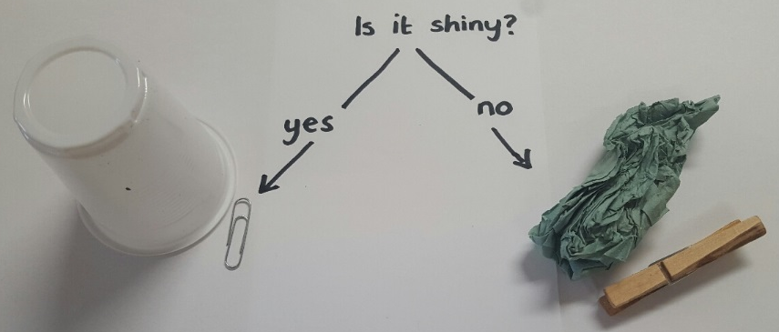
Lesson 1
Slide 3
L.O I can create an identification key.
Step 4 – continue this process until all materials are in a group of their own and then ta-da, you have created an identification key.
What is an identification key?
Step 1 – choose your first question. Then sort the materials into ‘yes’ or ‘no’.
Identify properties of the materials that you have to build the ship.
Step 2 – if there is more than one material in ‘yes’, write a new questions and sort. Do the same if there is more than one material in ‘no’.
Step 3 – if there is more than one material in ‘yes’, write a new questions and sort. Do the same if there is more than one material in ‘no’.

Slide 4
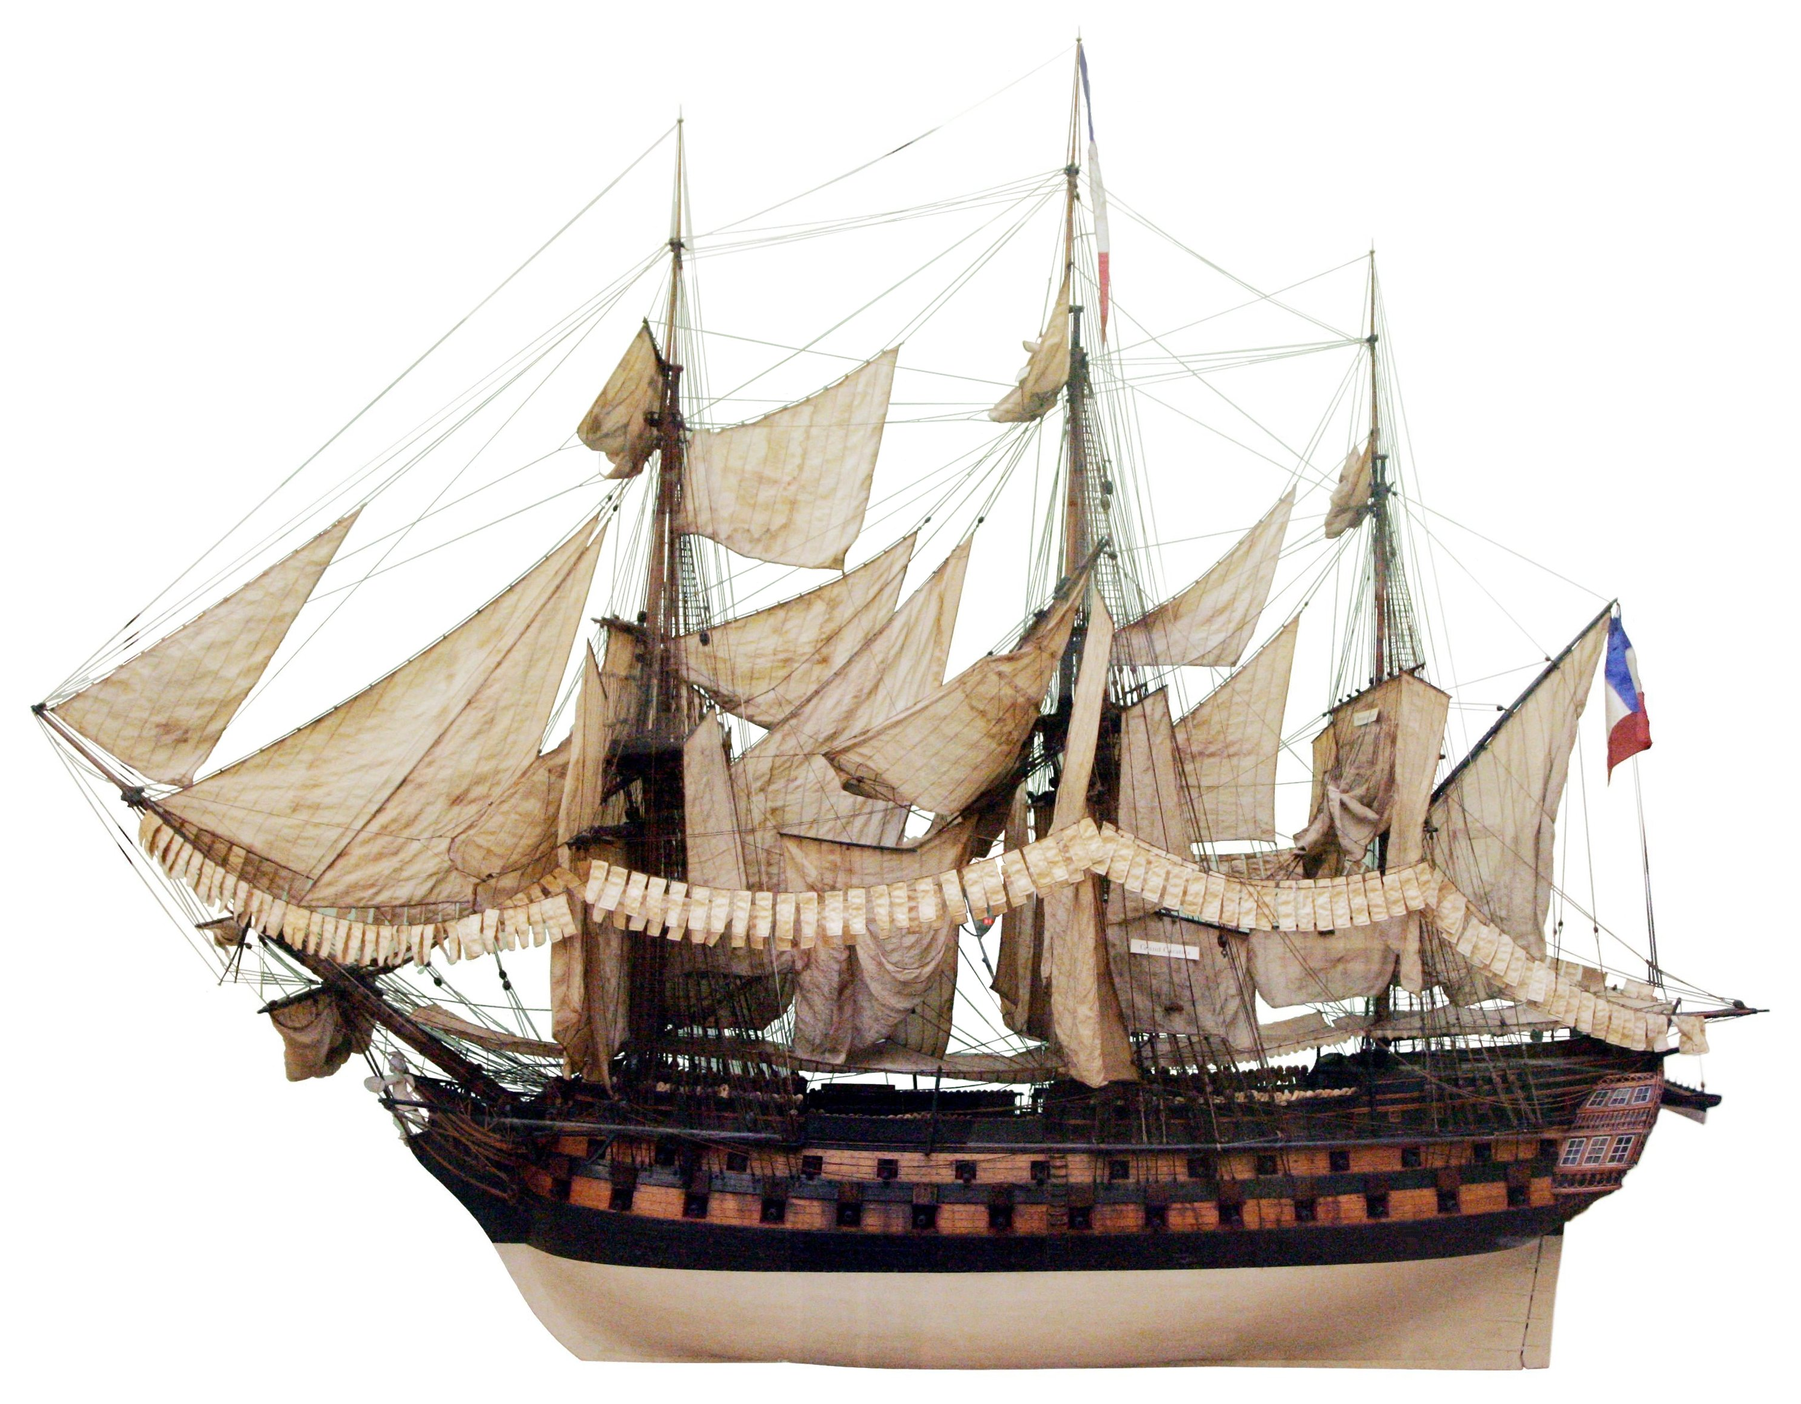
Lesson 2
Slide 1
L.O I can create an identification key.
main mast
sail
Identify properties of the materials, which you have collected to build the ship.
flag
bow
gunport
hull

Slide 5
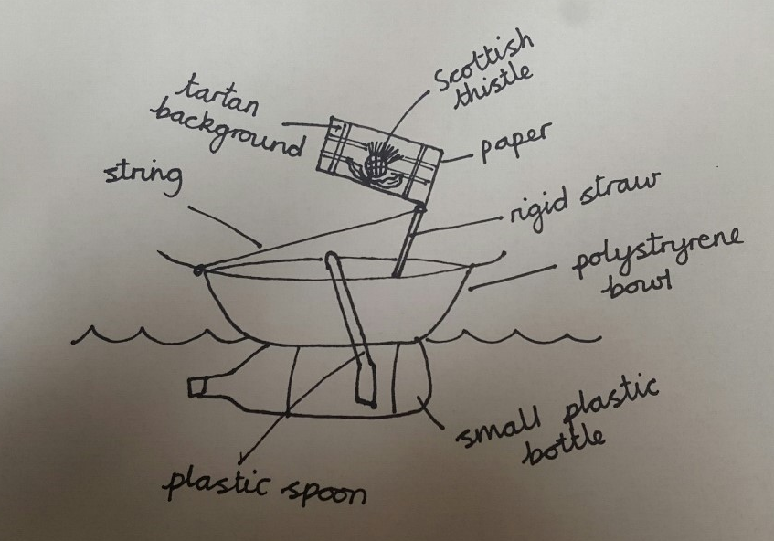
Lesson 2
Slide 2
L.O I can design a model and plan an experiment.
Use parts of each design to create your final design.
flag
Now you must design a ship. Don’t forget the ship should meet the 4 criteria we discussed in lesson 1.

