Slide 1
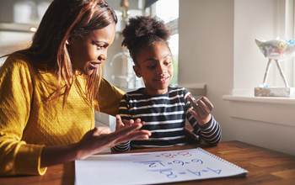
THE TEMPEST
Ideas and resources to support children at home

Slide 2
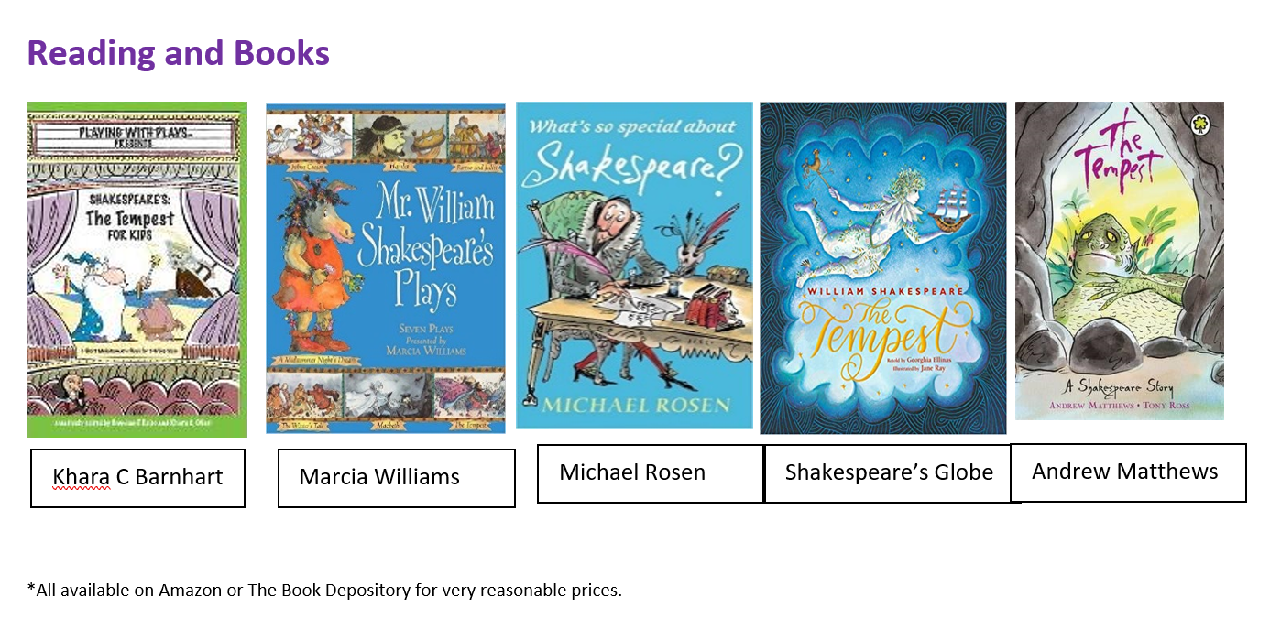
Reading And Books

Slide 3
Useful Video Synopses
Notes:
3

Slide 4
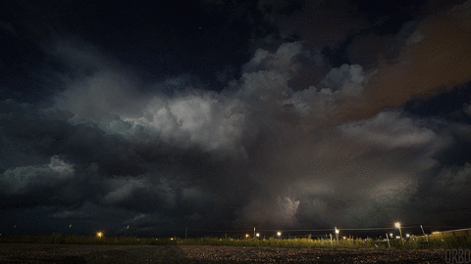
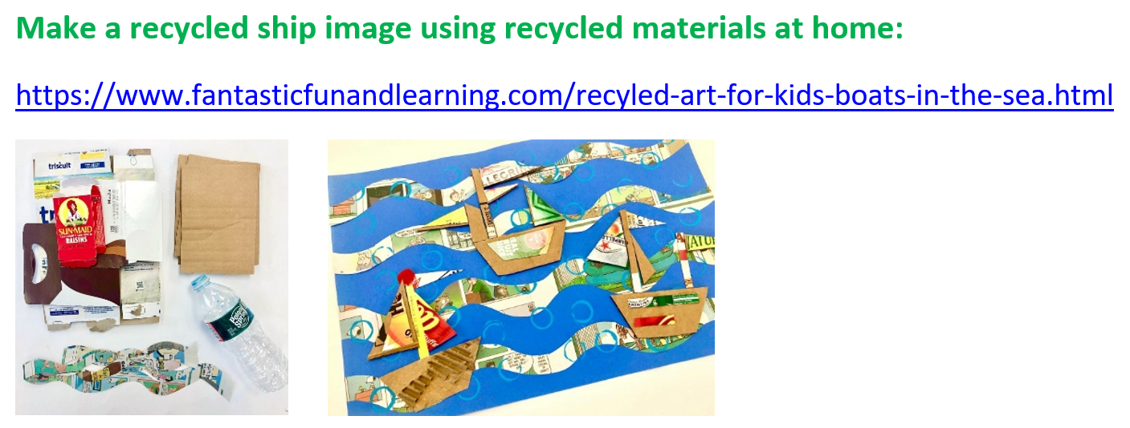
Art

Slide 6
Places To Visit

Slide 7
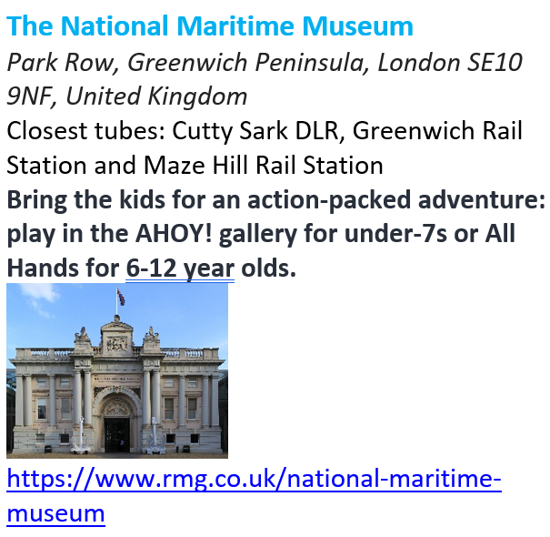

Slide 8
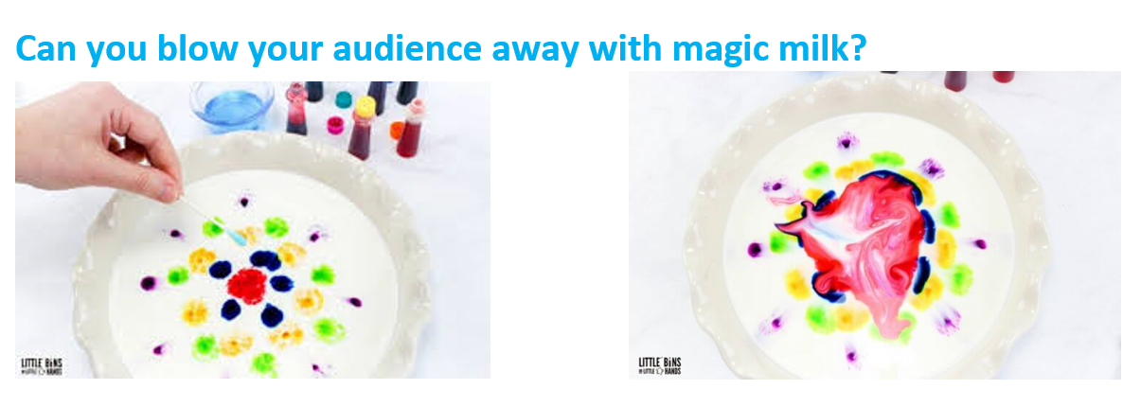
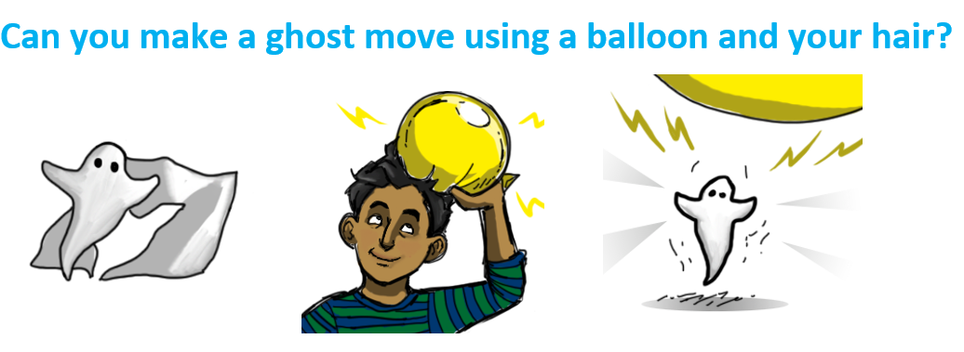
Science

Slide 9
Cooking

Slide 10
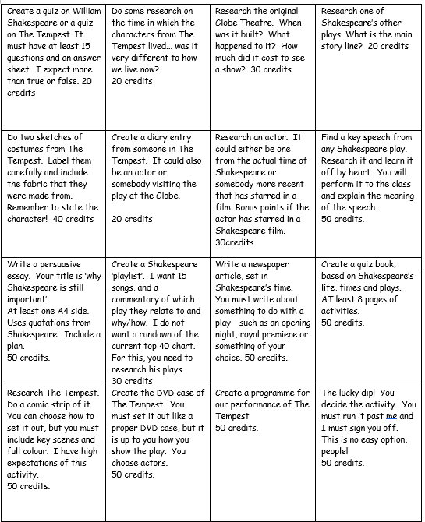
Homework Project
Children gain credits based on the number of activities they complete throughout the project!

Slide 11
Getting Parents Even More Involved…

