Slide 1
The Life of Hamlet
This Story is illustrated and written by Year 5
(Based on the play – Hamlet - by William Shakespeare

Slide 2
The play of Hamlet is a tragic and touching story,
The young prince of Denmark is experiencing the upsetting loss of his departed father.
But is the murderer closer to him than he realises?...

Slide 3
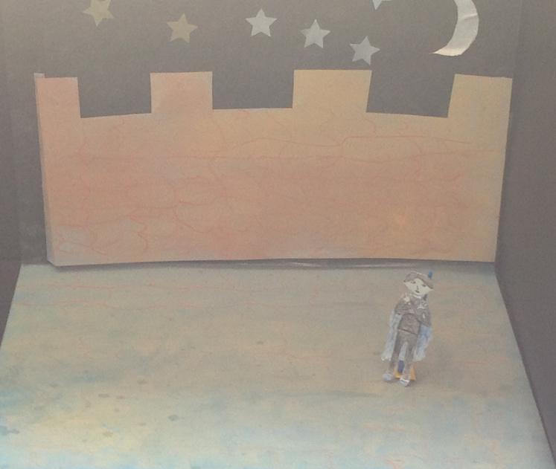
High on the top of Elsinore castle, Hamlet, an innocent Prince, stood shivering; his jaws clattered, as he anxiously waited for his dead father to appear as a ghost.
Is this real?
I'm freezing!

Slide 4
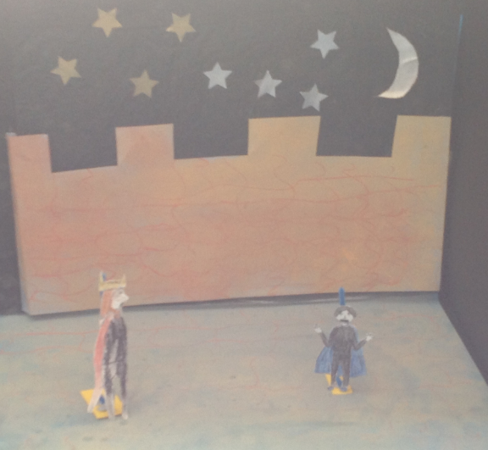
Yes, I am Hamlet!
Suddenly, out of nowhere, a ghostly figure appeared.
“Father, is that you?”
What!? Are you my father?

Slide 5
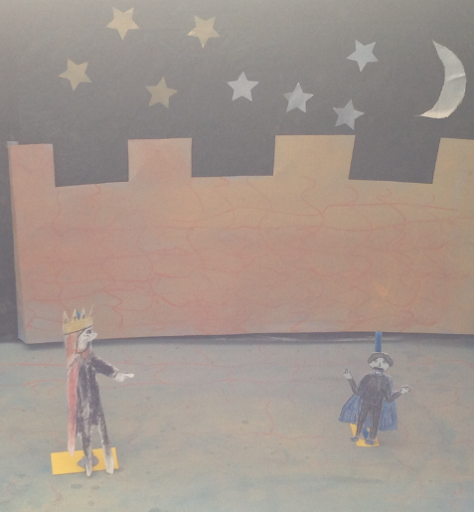
Yes Hamlet, revenge my most foul and unnatural murder!
The ghostly figure’s angry words echoed ominously through the air, as it began to reveal its deadly secret!
Father did Uncle Claudius murder you?

Slide 6
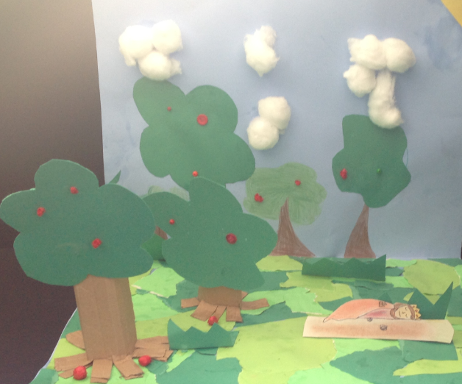
“In the orchard, I was sleeping, my custom always in the afternoon.”
Z Z Z Z Z Z Z Z Z Z

Slide 7
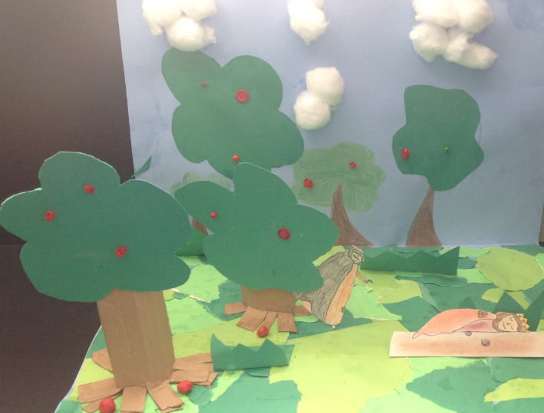
“Upon my secure hour, thy uncle stole, with juice of cursed hebenon in a vile.”
HA! HA! HA!
I love ruling Denmark, but I wish I could rule the world!

Slide 8
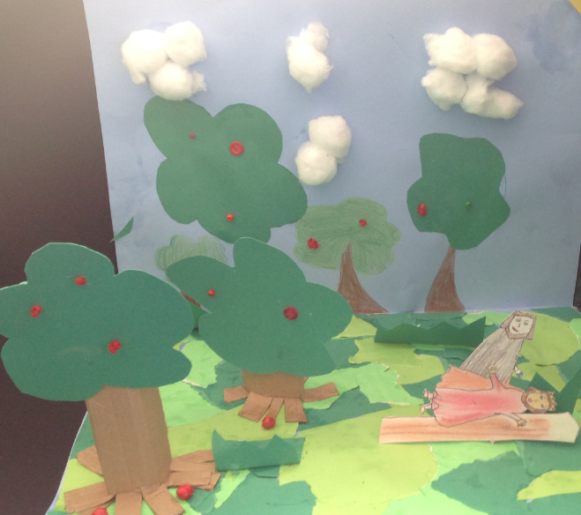
“And in the porches of mine ears, did pour the leprous distilment.”
I’m the king now! Ha!
Ha!
Mine own
Brother?!!

Slide 9
Hamlet was so distraught to find out his Uncle had betrayed his father, he didn’t know what to do.
“To be or not to be, that is the question.
Whether it is nobler in the mind to suffer
The slings and arrows of outrageous fortune
Or to take arms against a sea of troubles.
And by opposing, end them.
To die. To sleep. To sleep: Perchance to dream.”

Slide 10
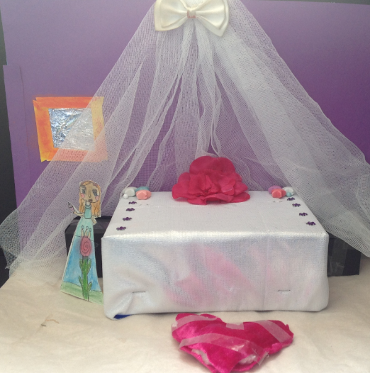
Meanwhile, gazing into her mirror, Ophelia was wishfully brushing her flowing, ginger hair, while wondering what it would be like to marry her true love: Hamlet.
La la la la la

Slide 11
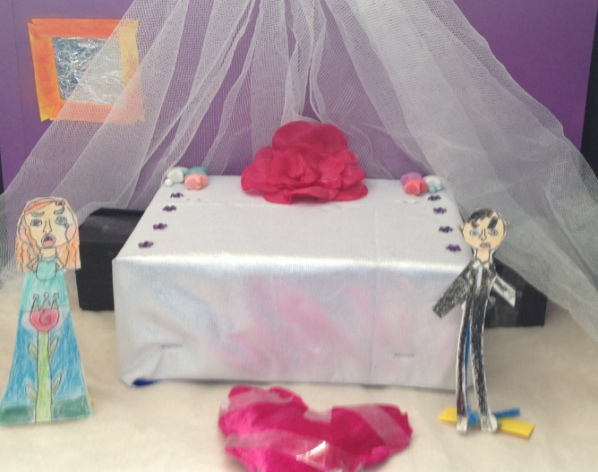
Without warning, her door crashed open, revealing a mad, angered Hamlet.
“I do not love you Ophelia! To a nunnery you go!” Hamlet screamed at poor Ophelia’s face.
I hate you - You swine!
What is going on?

Slide 12
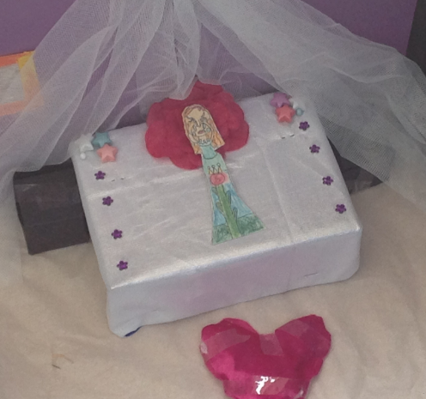
Ahh! Why did this have to happen to me?!
Ophelia was heartbroken and was left crying in her room.
Alone.

Slide 13
After hearing Hamlet treating Ophelia with such disrespect, Queen Gertrude summoned her son to find out what was bothering him.
Sneaky Polonius, who was helping King Claudius, decided to eavesdrop on Hamlet and his mother from behind the curtains, as he needed to discover whether Hamlet was actually mad!

Slide 14
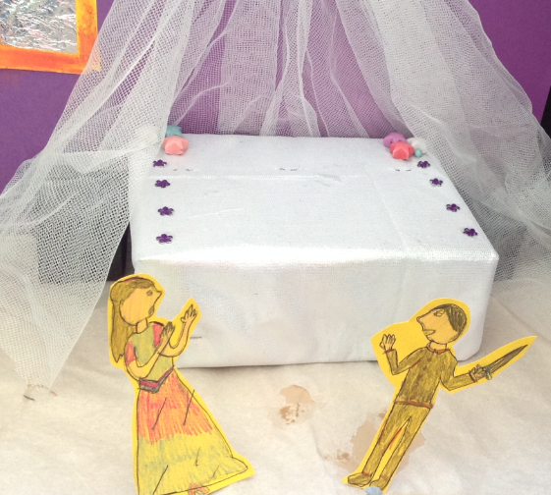
An argument brew up in the Queen’s chamber.
“Mother, you have my father much offended!”
Hamlet, why are you acting so mad today?

Slide 15
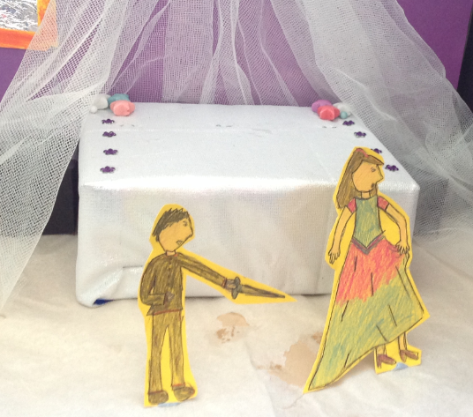
How dare you speak to me like this, and it’s none of your business!
“Hamlet, how dare you talk to me in this manner!”
Why did you marry my uncle?!

Slide 16
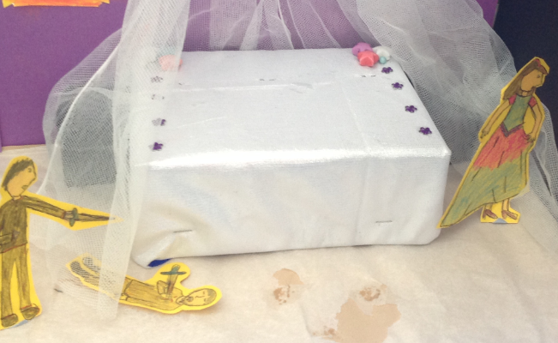
How could you ?!
“A rat!”
Exclaimed Hamlet as he heard a noise from behind the curtain.
“Intruding fool. Farewell!”
Ha! I got you!
OUCH!

Slide 17
After discovering the tragic death of her father and the rejection of her love, Ophelia became delirious with depression and confusion.
“There’s rosemary, that’s for remembrance…
And there is pansies, that’s for thoughts.
I would give you some violets, but they withered all when my beloved father died.”

Slide 18
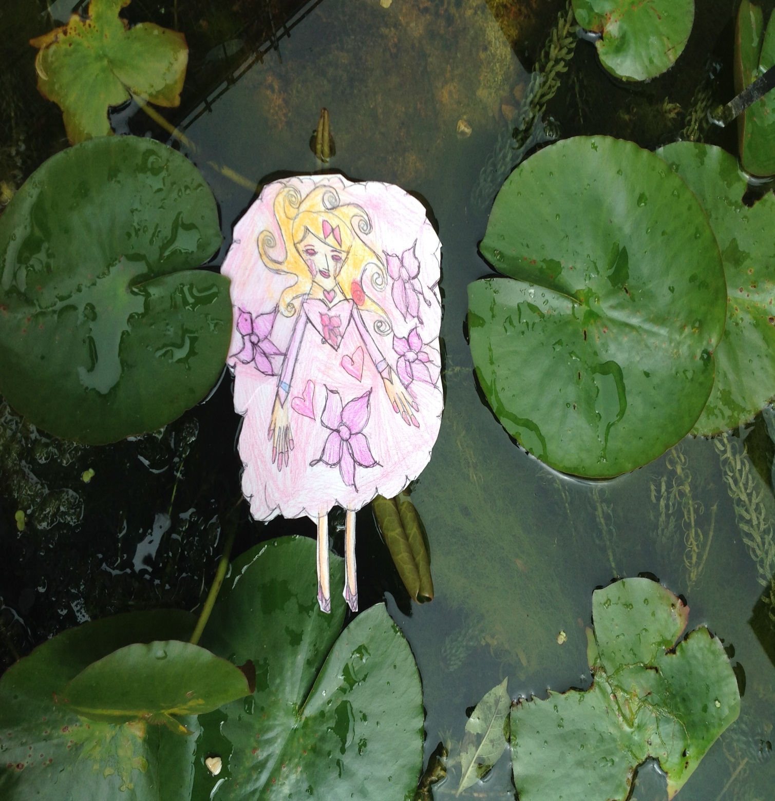
The many traumatising moments, led Ophelia to believe she could no longer survive.
Sadly, her body was discovered laying in the Castle’s lake surrounded by beautiful, but dead flowers.
Her life was wasted.

Slide 19
Meanwhile, Hamlet was putting his cunning plan into action to avenge his innocent dead father.

Slide 20
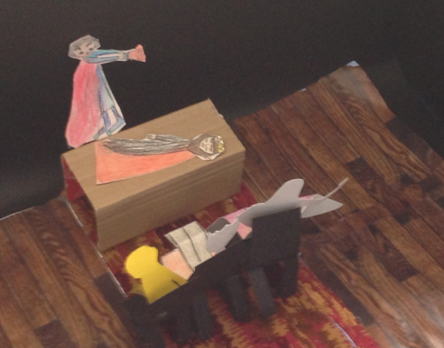
This show seems a little familiar..?
“What do you call the play?” Asked King Claudius.
“The Mouse Trap!” replied Hamlet with a smirk upon his face.

Slide 21
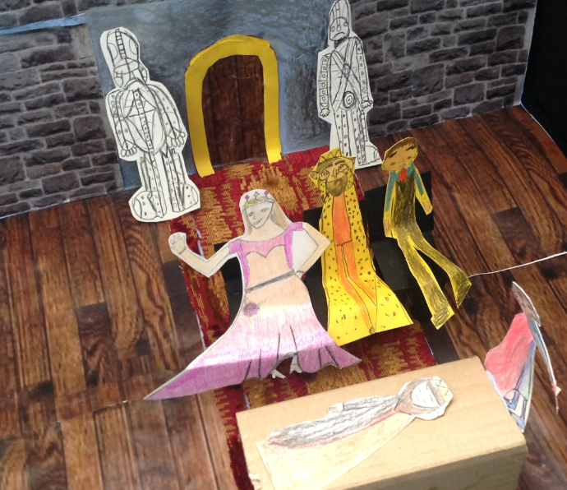
This show is boring.
Indeed!
Only moments into the play, King Claudius's face filled with horror, as he realised the play was a trap in order to expose his shameful secret.
Hamlet knows!

Slide 22
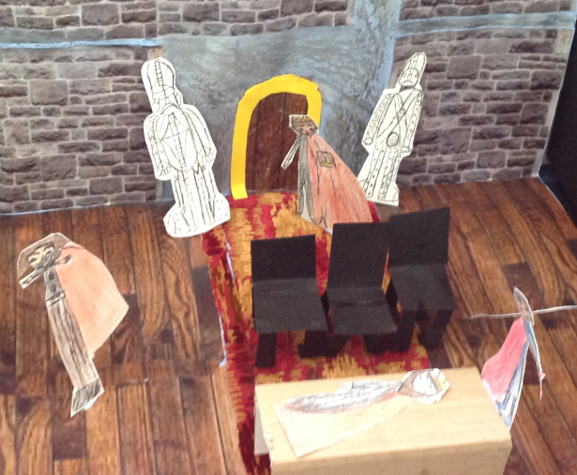
“Give all the play!” Cried the King, as he stormed out of the room in rage and fear, realising that Hamlet must have discovered his cruel secret.
AH! You imposter, what are doing!?
As I thought!
Ha! Ha! Ha!
They really have a problem!

Slide 23
After the play ended, King Claudius stormed out of the room. Meanwhile, Laertes (brother of Ophelia) had returned from a trip only to discover the tragic death of his sister and father. He was distraught, but furious at Hamlet after finding out he had killed his family.
Later that day, he decided to seek help from King Claudius and fortunately discovered that he too wanted the Prince dead.
Laertes decided to invite Hamlet to duel, however, King Claudius suggested one of the swords should be secretly poisoned.

Slide 24
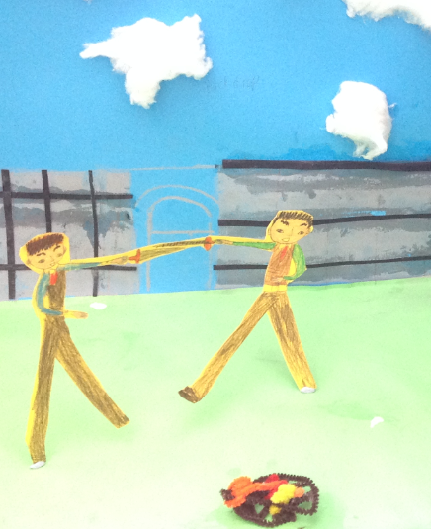
On guard!!
While Laertes and Hamlet were duelling, King Claudius decided to pour a “celebratory” cup of poison as a back up plan, in case Hamlet won the duel.
Die!

Slide 25
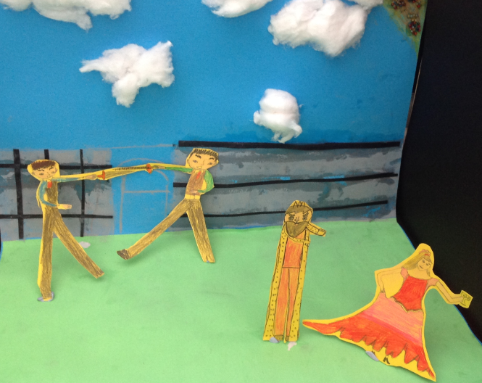
Unfortunately, poor unsuspecting Gertrude didn’t realise how horrid her husband was. She picked up the poisoned glass by mistake, and made a toast for her beloved son.
STOP!
Cheer for Hamlet!

Slide 26
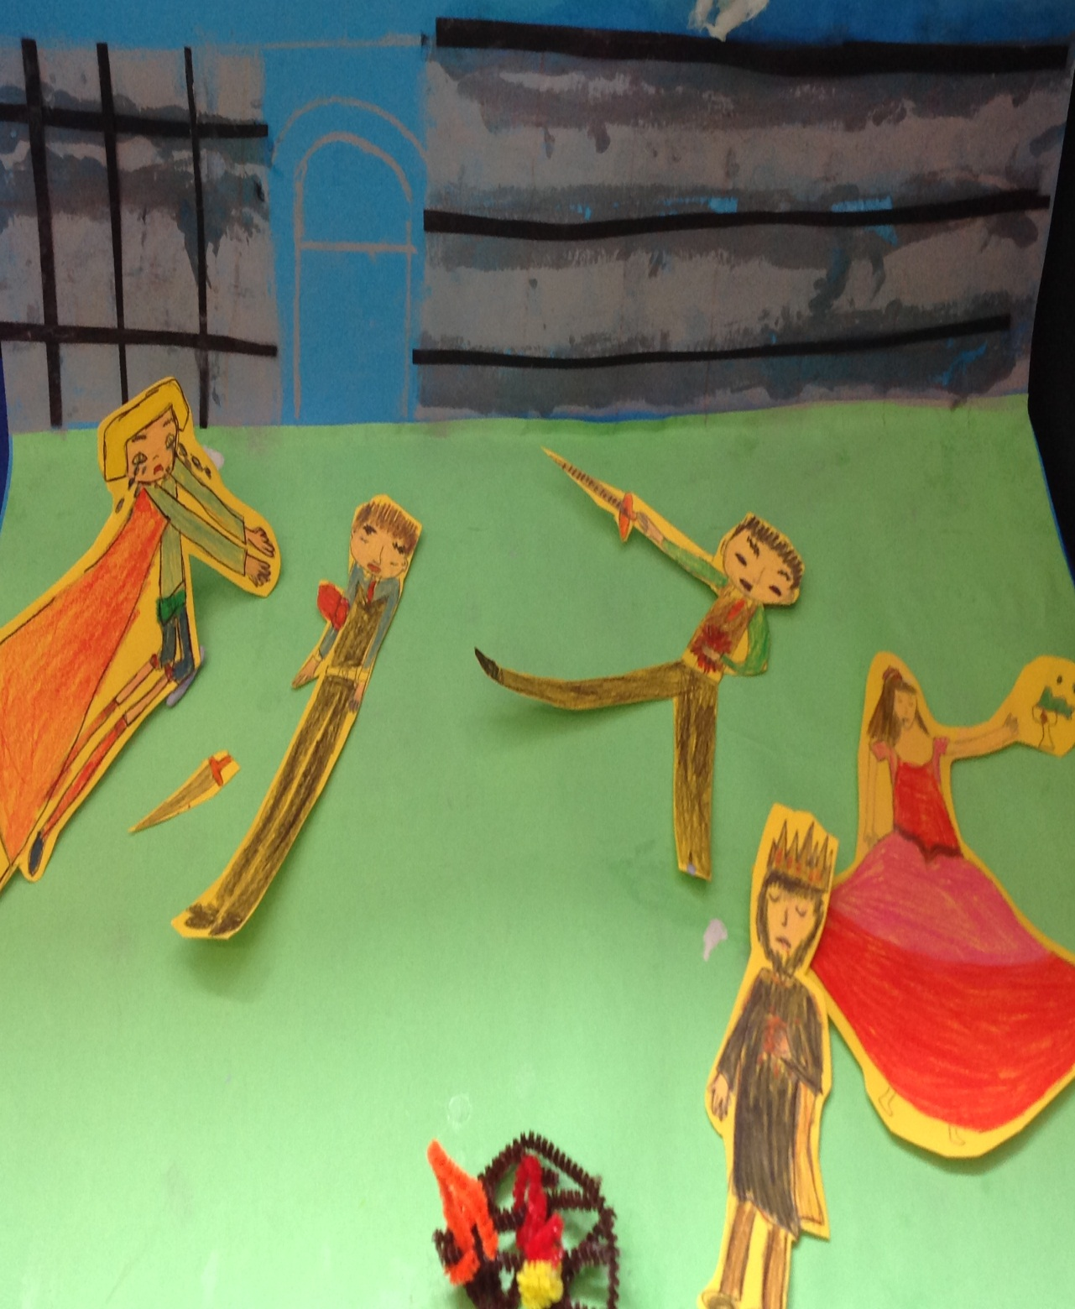
The King tried to stop her, but wasn’t quick enough…
The Royal family lay on the grass of the courtyard. Hamlet and Laertes - stabbed on their right arm - traces of poison from the sword in their wounds.
As for the King – Hamlet got to him just in time- and the Queen – she fatally drank the same leprous distilment, that had killed her first husband…
Why?!

